Slide 1
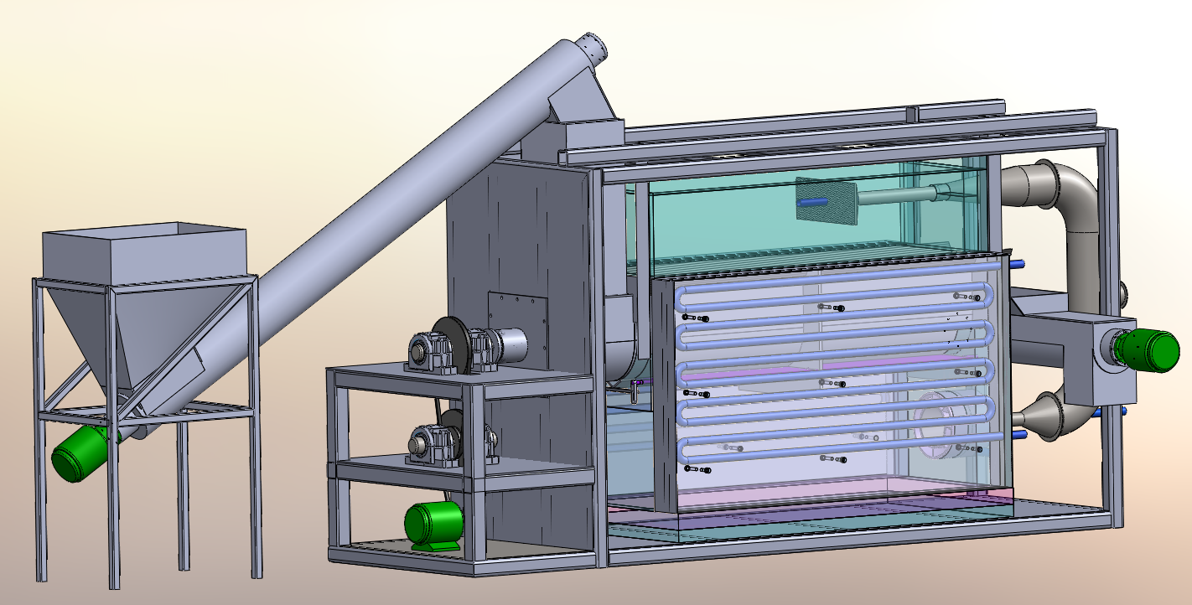
Support Frame
Pyrolysis Chamber
Feed Hopper
Char Outlet
Combustion Chamber
Main Trough
Drive System

Slide 2
תא פירוליזה
הוצעת ביו-שמן
מיכל הזנה
הוצעת ביו-צ'אר
תא בערה
מנועים

Slide 3
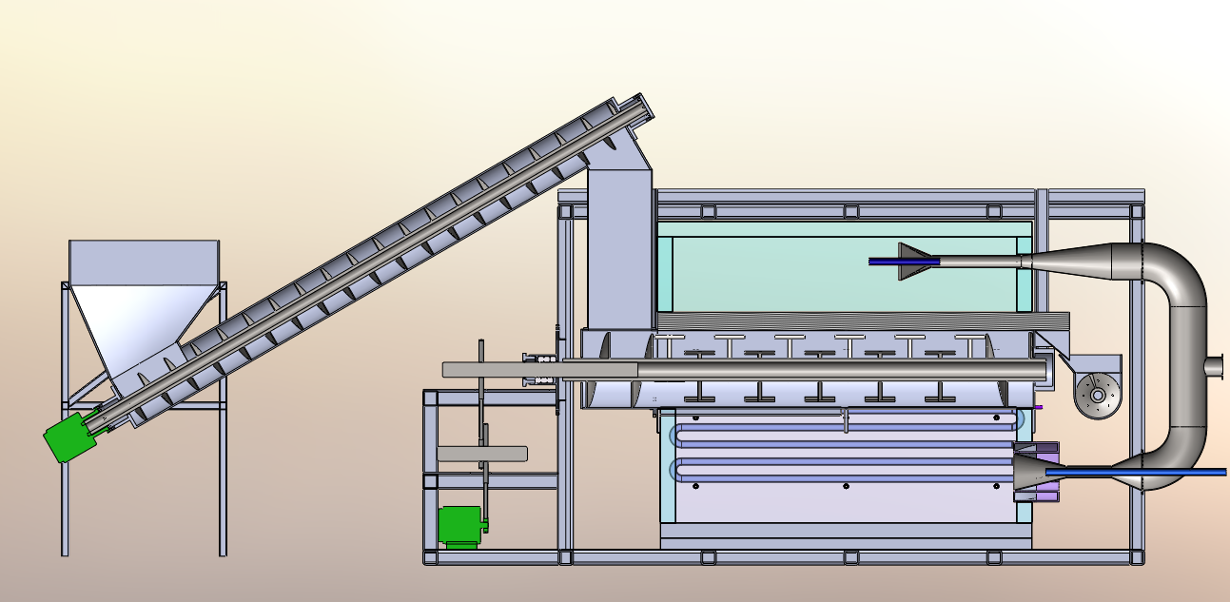
X Section View
Air Ejector
Bio-Oil Out
Main Burner
Main Stirring Auger
Preheated air for Ejectors

Slide 4
X Section View
Air Ejector
Bio-Oil Out
Main Burner
Main Stirring Auger
Preheated air for Ejectors

Slide 5
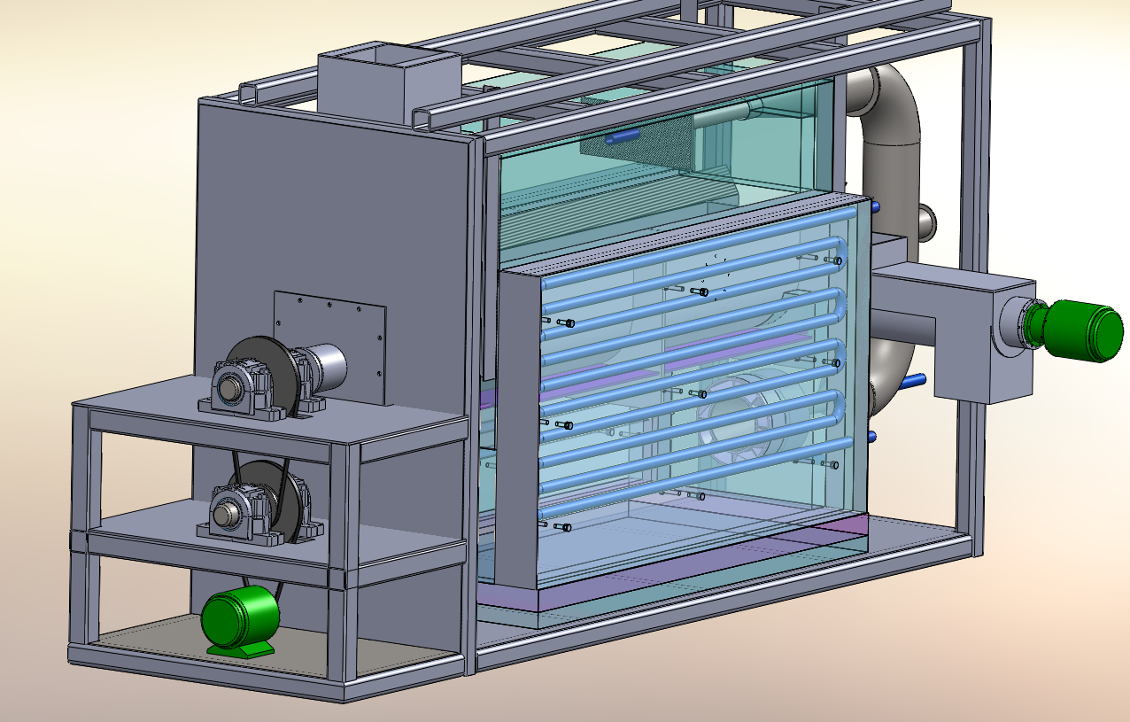
Drive system with dual bearing support and speed reduction

Slide 6
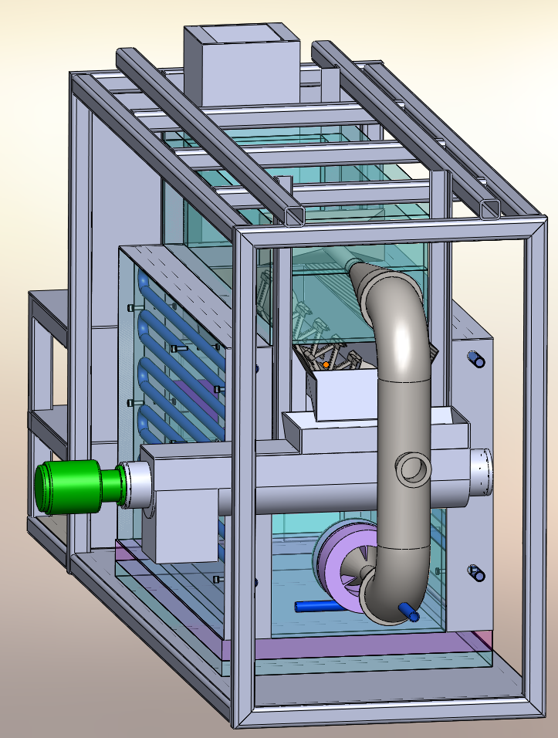

Slide 7
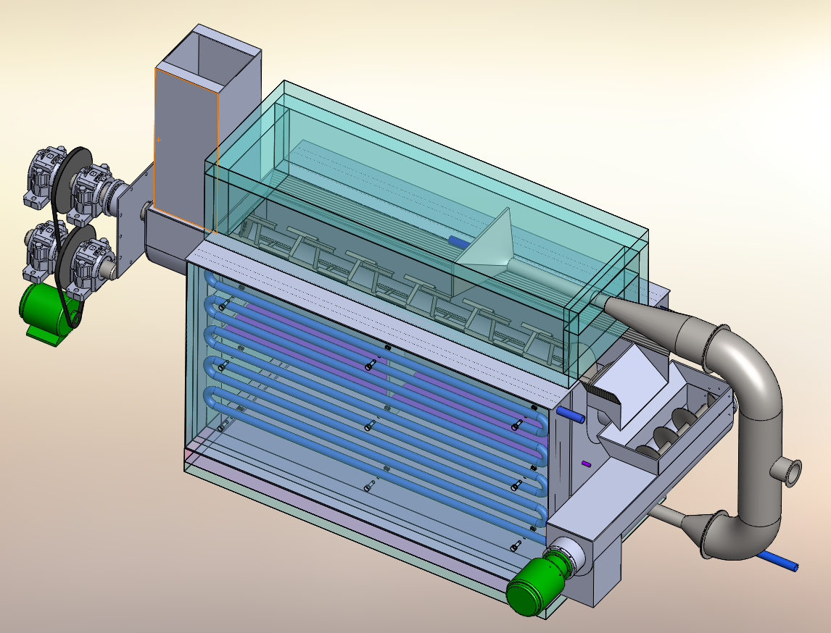

Slide 8
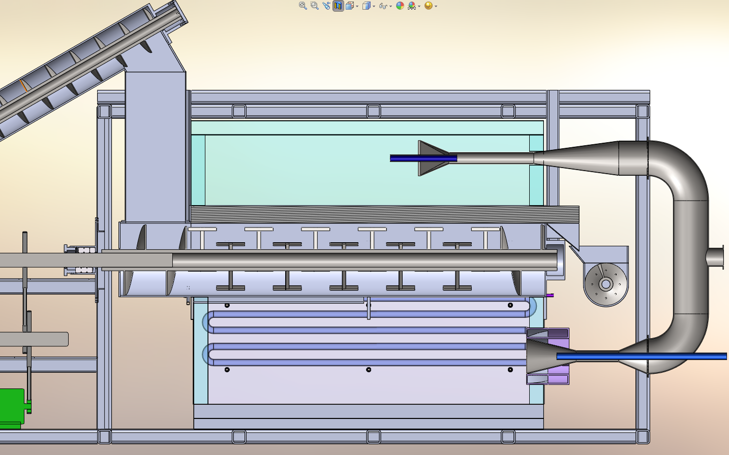

Slide 9
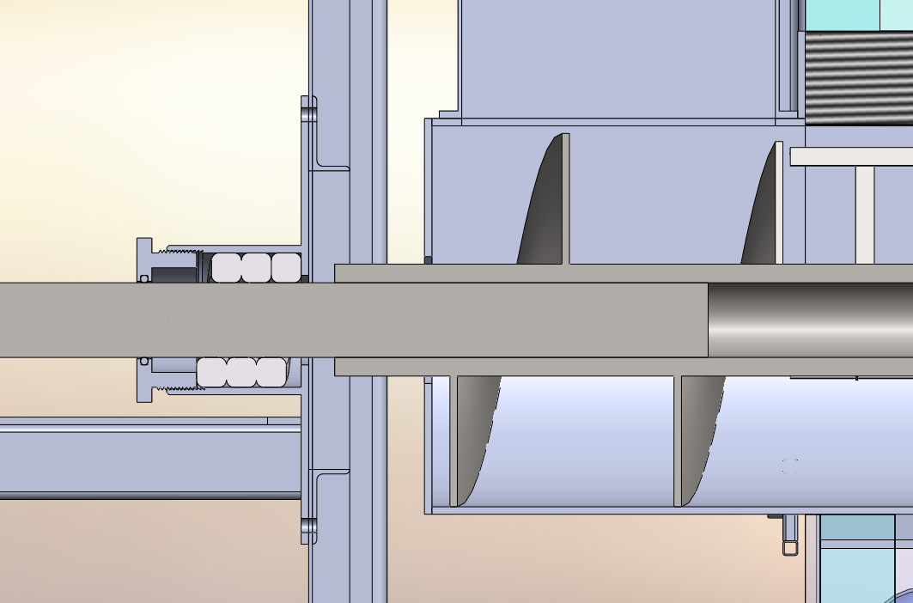
Rotating auger shaft
High temperature rope seal with adjustable seal cap to ensure a tight seal

Slide 10
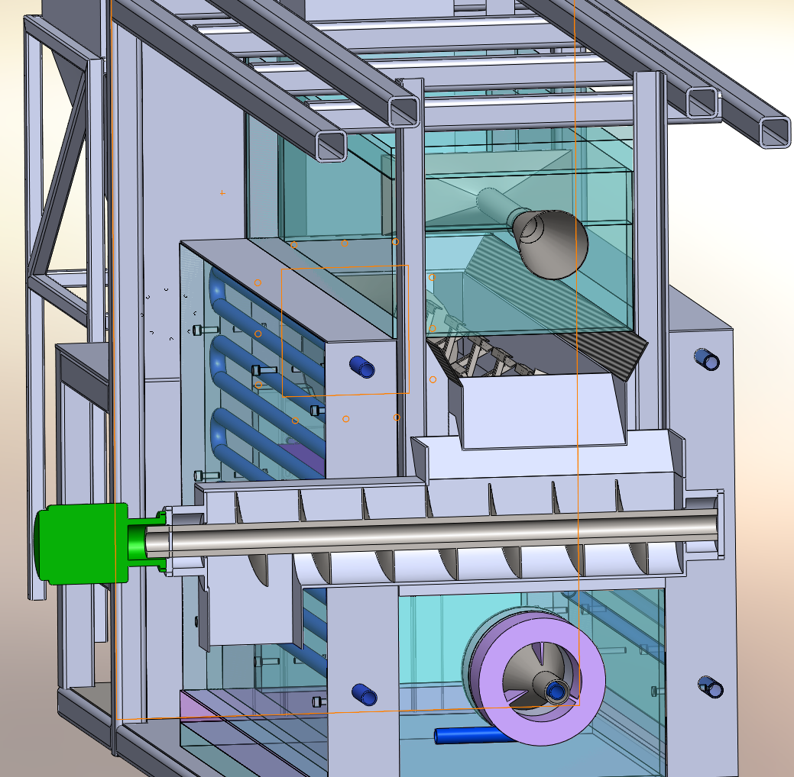
Vertical Trough Supports (front and back)
Biochar Out of Auger
Weir and Down ramp into small auger
Biochar Outlet

Slide 11
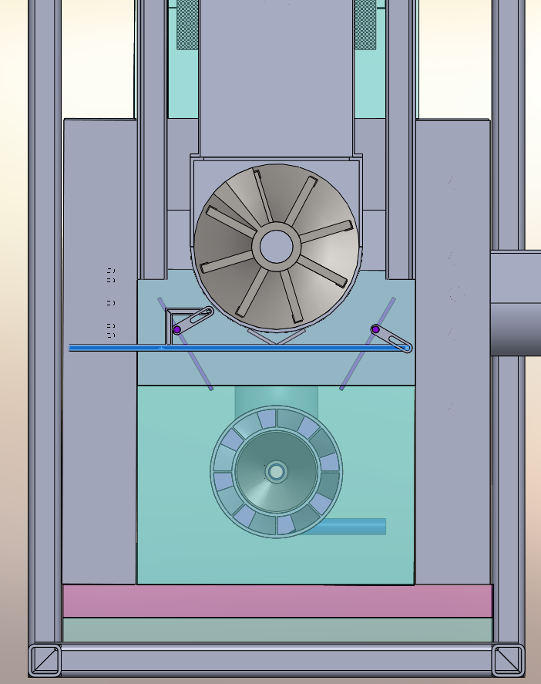
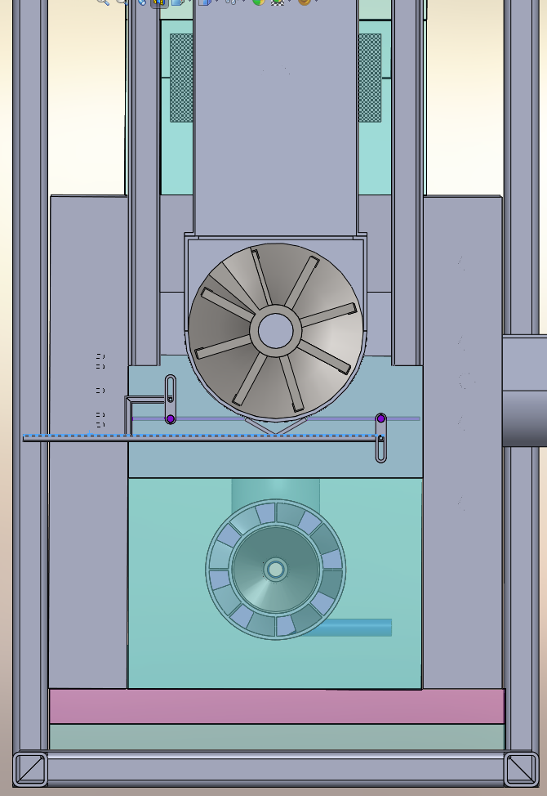
Baffles
Baffle Control Leaver
Baffles Opened
Baffles Closed

Slide 12
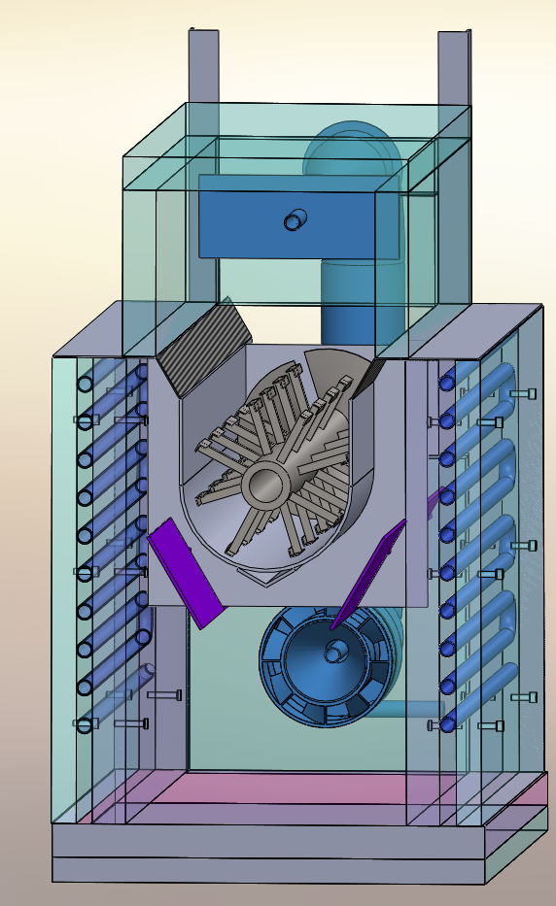
Heat Flow
Vents
Control Baffle
Burner

